Slide 1
Building a Web Application with Express.js
SHUBHAM THAKUR
ADIT-89

Slide 2
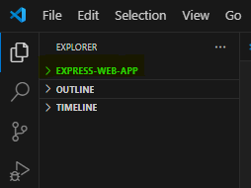
Project Setup
Creating a new directory and initializing the project.
mkdir express-web-app
cd express-web-app

Slide 3
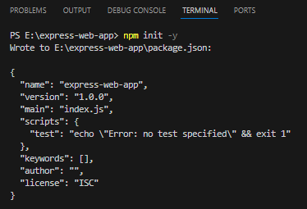
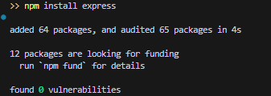
Installing Dependencies
npm init –y or only npm init and npm install express.

Slide 4
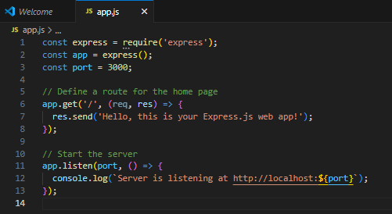
Writing the Express Application

Slide 5
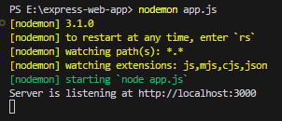
Running the Application
Demonstrating how to run the application using nodemon app.js.

Slide 6
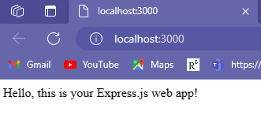
Viewing the Result.
Showing the result in the browser at http://localhost:3000.

Slide 7
Questions & Answers.

